Slide 1
SEG2105 – LAB 8
GitHub and Circle CI - Integrating Circle CI with your GitHub repository for Continuous Integration

Slide 2
Agenda
What is Continuous Integration (CI)
Work Flow
Need for Continuous Integration
Benefits of Continuous Integration
What are the tools available for CI
Requirements for Continuous Integration
Six practices for Continuous Integration
Concerns using Continuous Integration
Linking GitHub to Circle CI
Running automatic builds and unit tests in Circle CI

Slide 3
What is Continuous Integration?
Continuous Integration is a software development practice where members of a team integrate their work frequently, usually each person integrates at least daily – leading to multiple integrations per day.
Each integration is verified by an automated build (including test) to detect integration errors as quickly as possible.
Teams find that this approach leads to significantly reduced integration problems and allows a team to develop cohesive software more rapidly.

Slide 4
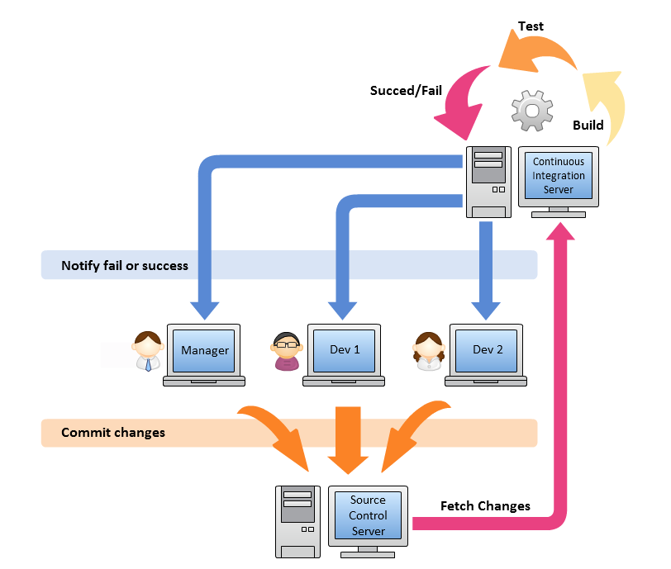
What is Continuous Integration? – Work Flow

Slide 5
What is Continuous Integration? – Work Flow
Developers check out code into their private workspaces
When done, commit the changes to the repository
The CI server monitors the repository and checks out changes when they occur
The CI server builds the system and runs unit and integration tests
The CI server assigns a build label to the version of the code it just built
The CI server informs the team of the successful build
If the build or tests fail, the CI server alerts the team
The team fixes the issue at the earliest opportunity
Continue to continually integrate and test throughout the project

Slide 6
Need for Continuous Integration
Teams use build definitions to ensure that every commit to the master branch triggers the automated build and testing processes.
Implementing CI this way ensures bugs are caught earlier in the development cycle, which makes them less expensive to fix.
Automated tests run for every build to ensure builds maintain a consistent quality.

Slide 7
Benefits of Continuous Integration
Reduced integration risk: More often than not, working on projects means multiple people are working on the separate tasks or parts of the code. The more people, the riskier the integration. Debugging and solving the issue can be really painful and can potentially mean a lot of changes to the code. Integrating on a daily basis or even more frequently can help reduce these kinds of problems to a minimum.
Higher code quality: Not having to worry about the problems, and focusing more on the functionality of the code results in a higher quality product.
The code in version control works: If you commit something that breaks the build, you and your team get the notice immediately and the problem is fixed before anyone else pulls the “broken” code.

Slide 8
Benefits of Continuous Integration (Cont.)
Reduced friction between team members: Having the impartial system in place reduces the frequency of quarrels between team members.
Less time deploying: Deploying projects can be very tedious and time-consuming, and automating that process makes perfect sense.

Slide 9
Tools available for CI
There are a lot of open source and premium tools available in the market for continuous integration.
Few Tools:
Jenkins, TeamCity, Travis CI, Go CD, Circle CI, Bamboo, GitLab CI, Code Ship.
We will be using Circle CI for this lab.

Slide 10
Requirements for Continuous Integration
The first requirement is having the version control system (VCS). There is no way around it and there shouldn’t be a way around it. VCS provides a reliable method to centralize and preserve changes made to your project over time.
You will need to install one of the many available continuous integration tools.
We are going to use Circle CI.

Slide 11
Six practices for Continuous Integration
Commit code frequently
Don’t commit broken code
Write unit tests
Fix broken builds immediately
All tests must pass
Avoid breaking code

Slide 12
Concerns using Continuous Integration
Increased project maintenance overhead: You already need to build, test and deploy your systems. If you don’t manage those processes with the CI, you will be managed by those processes. Once the project gets to the certain complexity, it becomes incredibly hard to manage.
Too much change: People might be unwilling to make so many changes to implement the CI on their legacy system. If that is the case, you can easily introduce CI to the system one part at a time. Once the team members are comfortable with the results, CI can be introduced to the other parts as well.

Slide 13
Concerns using Continuous Integration (Cont.)
Hardware/Software costs: Costs of implementing a CI could be perceived as unnecessary by both developers and management on a project. But these costs are marginal compared to the costs of the maintenance and finding the problems later down the line.
Project too small: Even the smallest projects can benefit from CI. Especially with the plethora of online Continuous Integration tools that are very easy to set up.

Slide 14
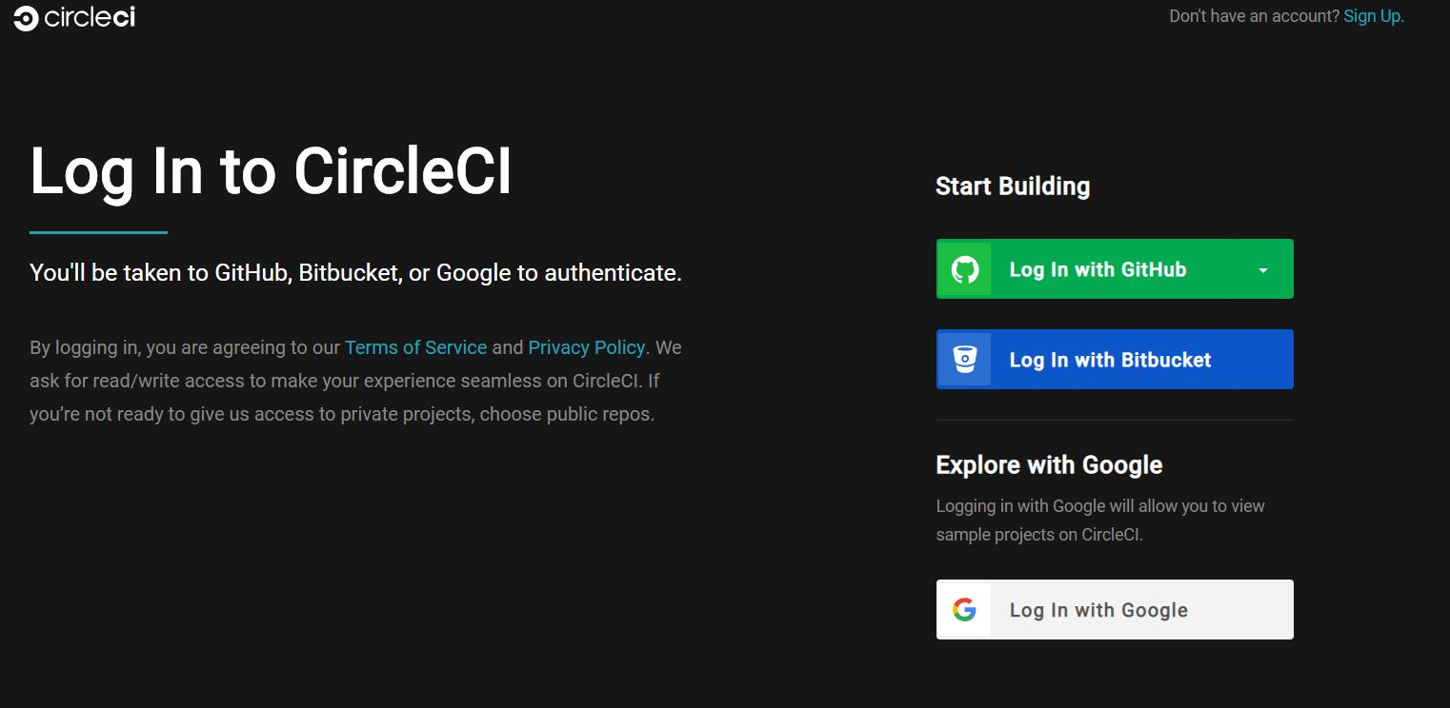
Linking GitHub to Circle CI
Visit the official website of Circle CI using this link: https://circleci.com/vcs-authorize/
Login using your GitHub credentials where your project repository exists:

Slide 15
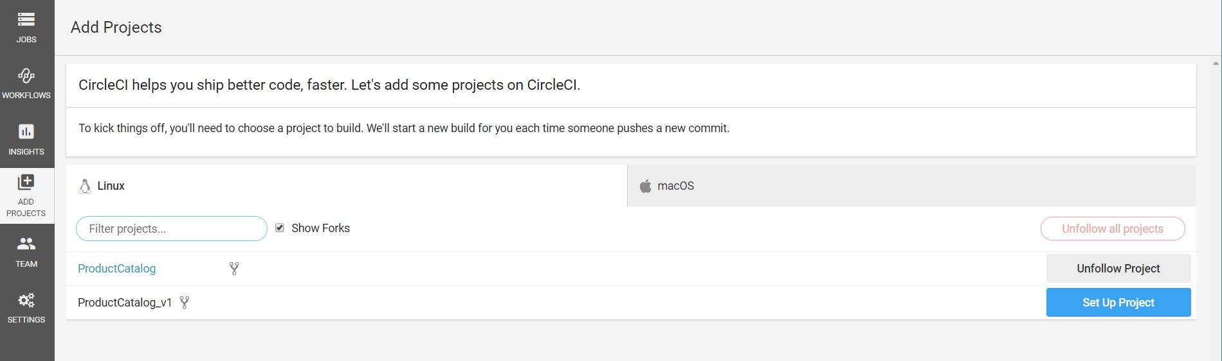
Linking GitHub to Circle CI (Cont.)
Click on Add Projects and then on Set Up Project:
Once, you have added the project to Circle CI. We move on to our project in android studio.

Slide 16
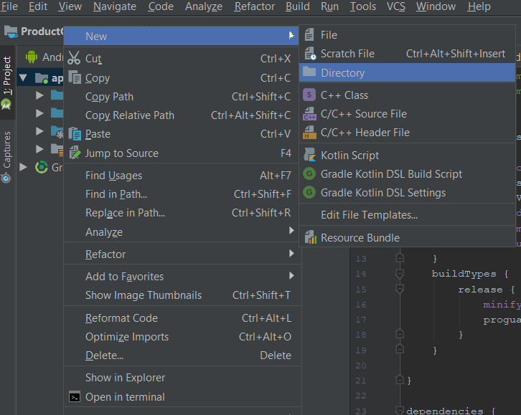
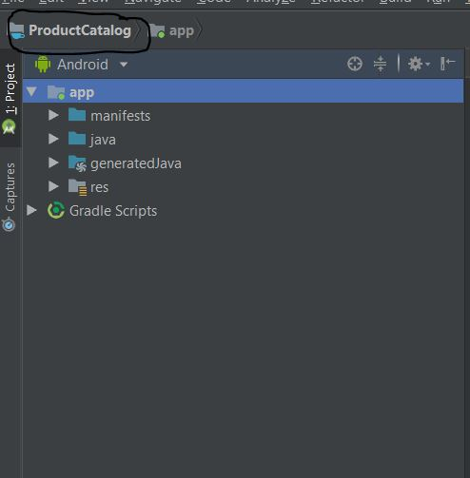
Linking GitHub to Circle CI (Cont.)
Here we create a “.circleci ” folder and create an “config.yml” file.
In order to create “.circleci” folder, you cannot create it directly so just open your project in android studio.
Create a directory named: “.circleci”

Slide 17
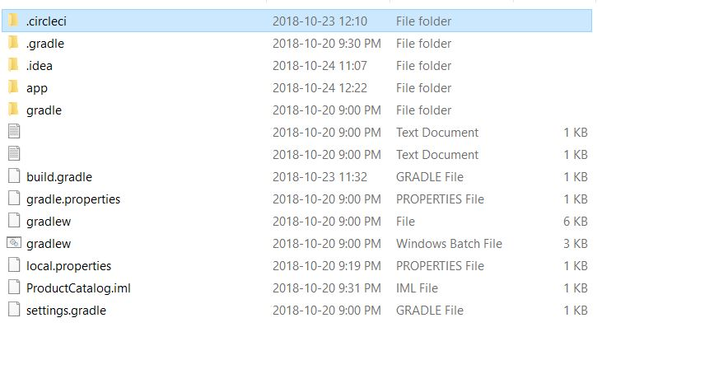
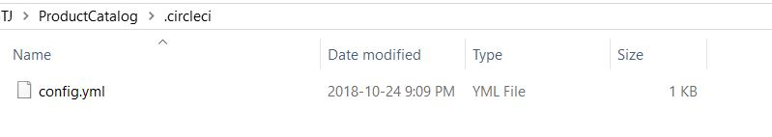
Linking GitHub to Circle CI (Cont.)
Now, access this folder in the file system of windows. Add “Config.yml” to this folder.

Slide 18
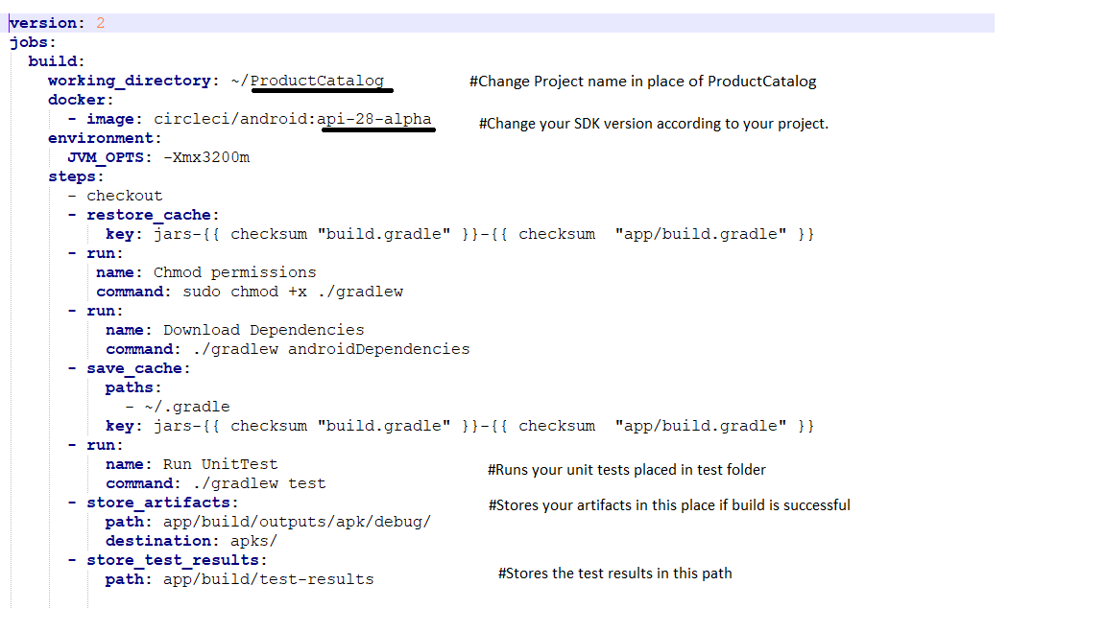
Linking GitHub to Circle CI (Cont.)
Now, Add the below provided code to the config.yml file. Do not miss the alignment of the code. Code can be found here.
Notes:
version: 2
jobs:
build:
working_directory: ~/ProductCatalog
docker:
- image: circleci/android:api-28-alpha
environment:
JVM_OPTS: -Xmx3200m
steps:
- checkout
- restore_cache:
key: jars-{{ checksum "build.gradle" }}-{{ checksum "app/build.gradle" }}
- run:
name: Chmod permissions
command: sudo chmod +x ./gradlew
- run:
name: Download Dependencies
command: ./gradlew androidDependencies
- save_cache:
paths:
- ~/.gradle
key: jars-{{ checksum "build.gradle" }}-{{ checksum "app/build.gradle" }}
- run:
name: Run UnitTest
command: ./gradlew test
- store_artifacts:
path: app/build/outputs/apk/debug/
destination: apks/
- store_test_results:
path: app/build/test-results

Slide 19
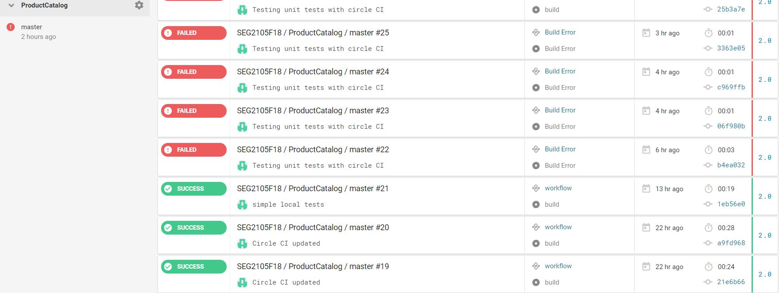

Linking GitHub to Circle CI (Cont.)
Save the file!!!
Once everything is setup. Commit and push your code and files to your GitHub Repository.
After pushing the code, open Circle CI and click on “Start Building” to verify whether your build and tests are successful.

Slide 20
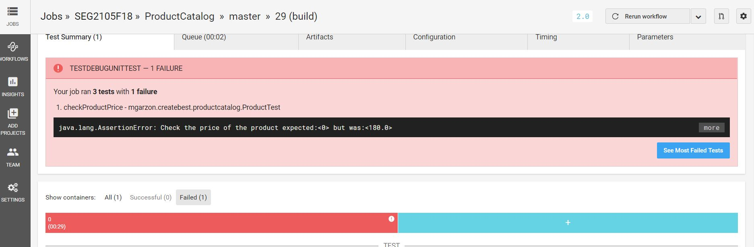
Linking GitHub to Circle CI (Cont.)
You can click on the title of the build to verify the summary of the results.
The below provided image consists of 1 failed test in available 3 tests.

Slide 21
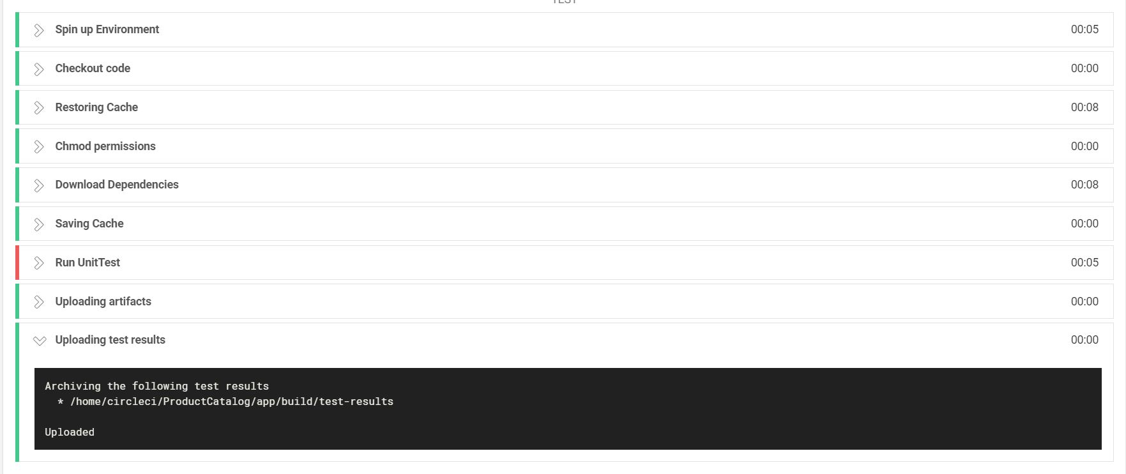
Linking GitHub to Circle CI (Cont.)
If there are any other errors due to any other issues you can verify by expanding each step of the process.

Slide 22
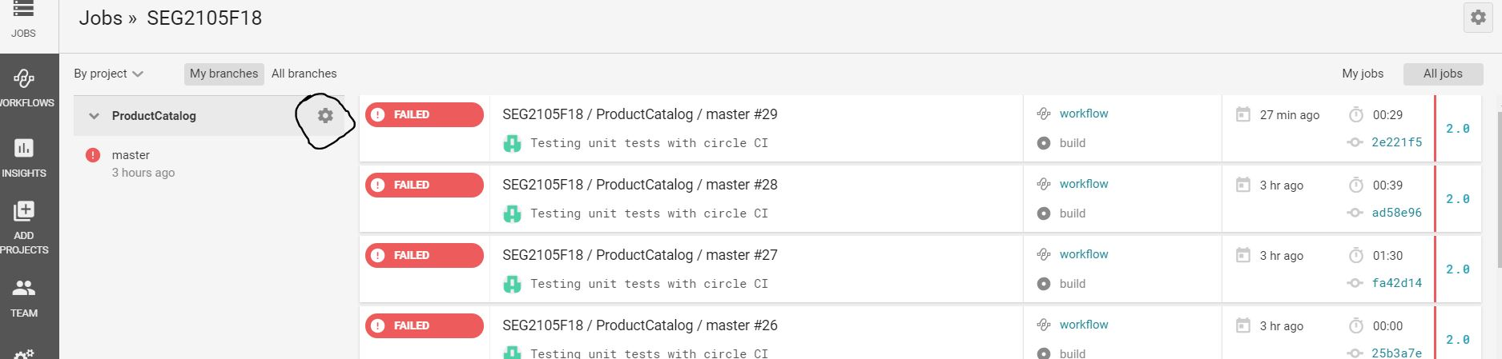
Linking GitHub to Circle CI (Cont.)
How to customize when to build the project and run the tests?
Click on the settings icon beside your project.

Slide 23
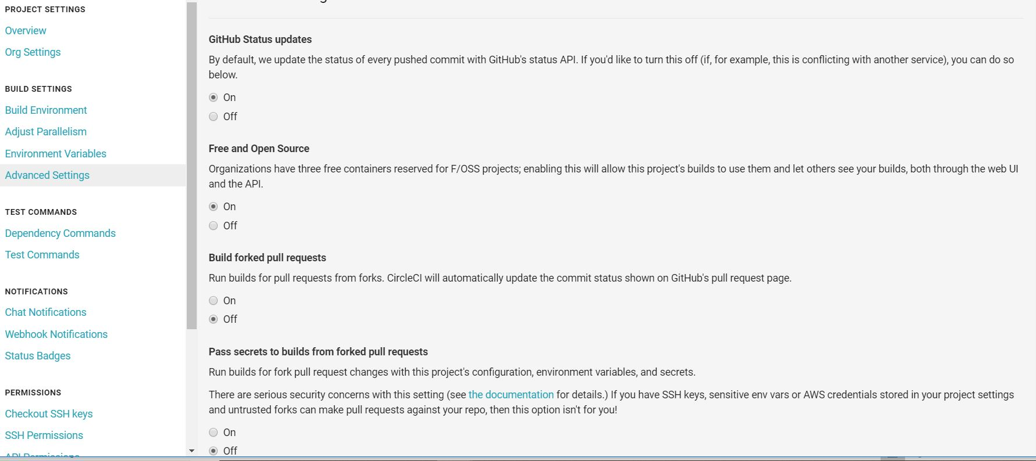
Linking GitHub to Circle CI (Cont.)
Now, click on Advanced Settings to find various options on when to build the project. That’s it DONE!!

Slide 24
Your turn!

Slide 25
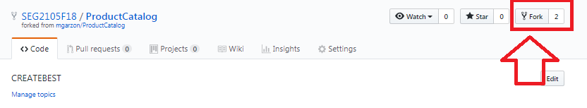
Task:
Fork the below provided project to your GitHub repository.
Project Link: https://github.com/SEG2105F18/ProductCatalog
Integrate it with Circle CI for continuous integration by following along with the above steps starting from Slide 14 (Linking GitHub to Circle CI).
The /.circleci/config.yml has already been added. You may want to edit to match your SDK version.
Fix the test case that is failing.
Push your code to your GitHub repository and verify the build and test results in Circle CI.
Show your build results to the TA. That is, show to the TA your circleci console of successful build.

Slide 26
References
https://proandroiddev.com/circleci-with-android-continuous-integration-3ecd98f92bd4
https://martinfowler.com/articles/continuousIntegration.html
https://circleci.com/docs/2.0/language-android/
https://circleci.com/continuous-integration/

Slide 27
THANK YOU!

